Slide 1
Deploying SharePoint Framework components to production
Updating web parts

Slide 2
Agenda
Update the web part and solution
Package the solution
Deploy the updated solution and assets
Q&A

Slide 3
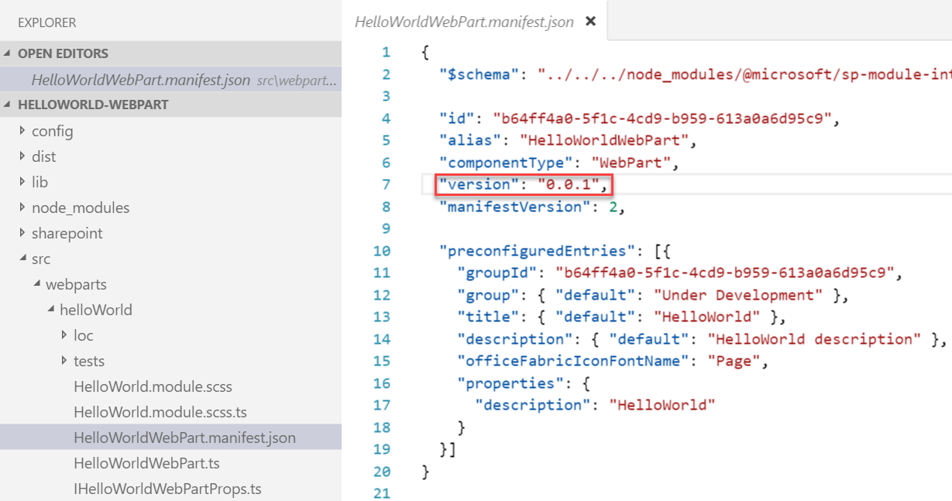
Update a web part and increment the version
Update the code or configuration for your web part
Increment the version in the <web part name>.manifest.json file
This sets the version for the web part
Multiple web parts in the same solution may be versioned independently

Slide 4
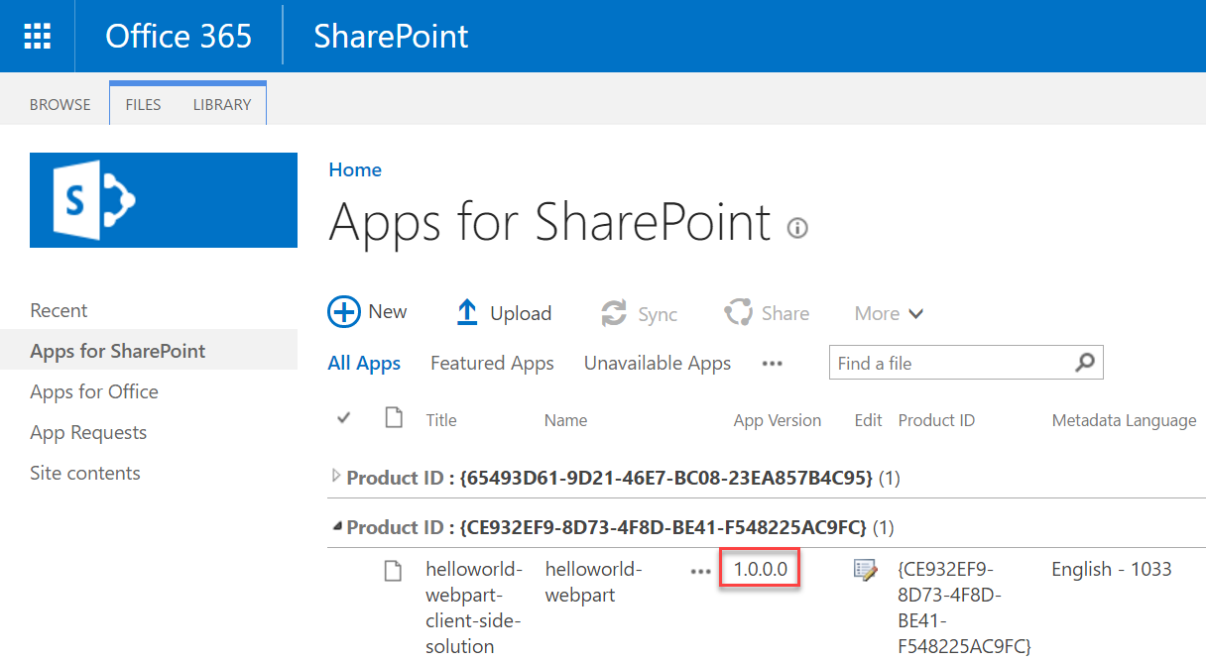
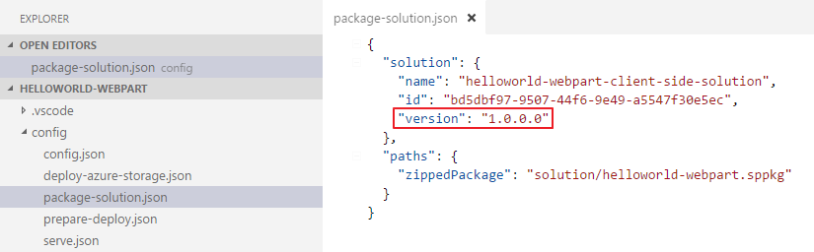
Update the version in the package-solution.json file
This sets the version for the .sppkg Add-in
This version is displayed in the app catalog

Slide 5
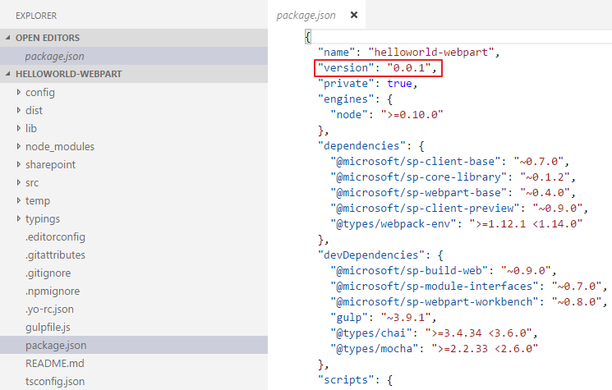
Update the version in the package.json file
Change the version every time the package changes
Notes:
The most important things in your package.json are the name and version fields. Those are actually required, and your package won't install without them. The name and version together form an identifier that is assumed to be completely unique. Changes to the package should come along with changes to the version.
Version must be parseable by node-semver, which is bundled with npm as a dependency. (npm install semver to use it yourself.)
More on version numbers and ranges at semver.

Slide 6
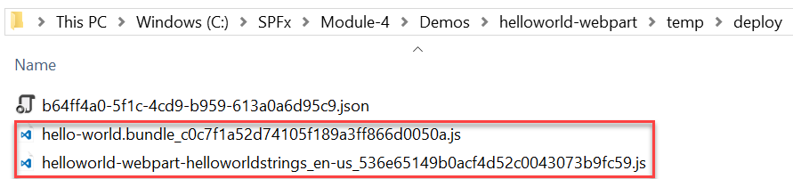
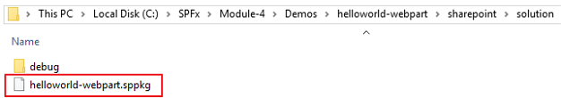
Package the web part
Use the bundle gulp task to build, localize, and bundle the project
Use the package-solution gulp task to package the project into a .sppkg file
The ship parameter build task creates a minified version of the bundle and copies all of the web part assets, including the web part bundle, into the temp\deploy folder. The .sppkg folder is generated in the sharepoint\solution folder.
> gulp bundle --ship
> gulp package-solution --ship

Slide 7
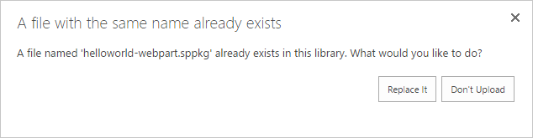
Deploy App to the SharePoint App Catalog
Go to your Office 365 App Catalog site
In the left sidebar, choose Apps for SharePoint
Upload the updated package (.sppkg file) for the web part

Slide 8
Deploy the updated web part assets to CDN
See the following sections for more information about CDN deployments
Deploying to SharePoint CDN
Deploying to Azure Storage CDN

Slide 9
Refresh the SharePoint page of the web part
You don’t need to install the App again
Refresh the SharePoint page where the web part was added, the update you made will take effect

Slide 10
Summary
Update the web part and solution
Package the solution
Deploy the updated solution and assets
Q&A

Slide 11
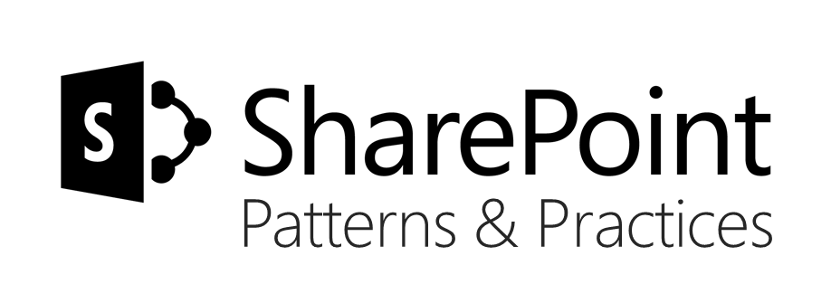
Sharing is caring…
Code samples and solutions
Reusable components
Guidance documentation
Monthly community calls
SharePoint Framework
SharePoint add-ins
Microsoft Graph
Office 365 APIs
http://aka.ms/SharePointPnP

Slide 12

Q&A

Slide 13


